Slide 1

Implementing Lean Production
in the Pork Industry
Notes:
Please note, there are accompanying notes for a number of the presentation slides

Slide 2
Lean Production
Farmers are great examples of ENTREPRENEURS.
Working within the agrifood industry to produce food/energy/environmental benefits in the most efficient way possible. While traditionally farmers have remained on their family farm, it is now more common for those working within the agrifood industry to work away from home, as new technology enables food to be produced underground (salad leaves), in standalone units (mushrooms) and on top of buildings (bee hives).
Farms, like all businesses, must be well managed to have a future, by maximising revenue and minimising costs. Ensuring that production processes are efficient will help increase the chances of success, but what does that look like on a pig farm?
&

Slide 3
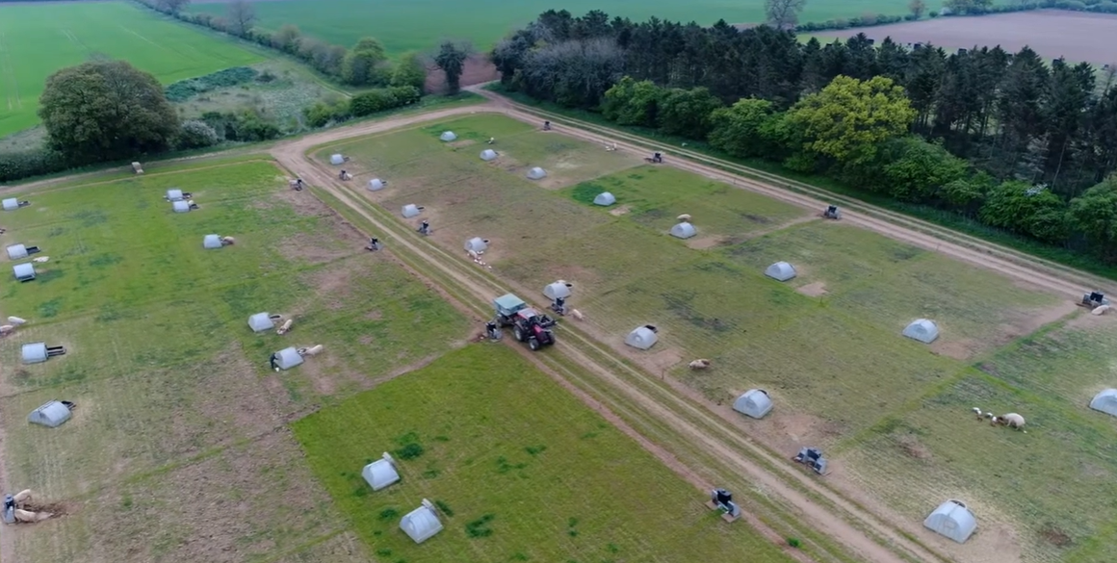
How do farmers raise pigs for
the pork industry?
40% of sows (female) pigs are kept outdoors in the UK. This is often dependent on soil type as it needs to be very well draining to avoid damage when they are rooting around for food.
Notes:
Press Control and Click to start video

Slide 4
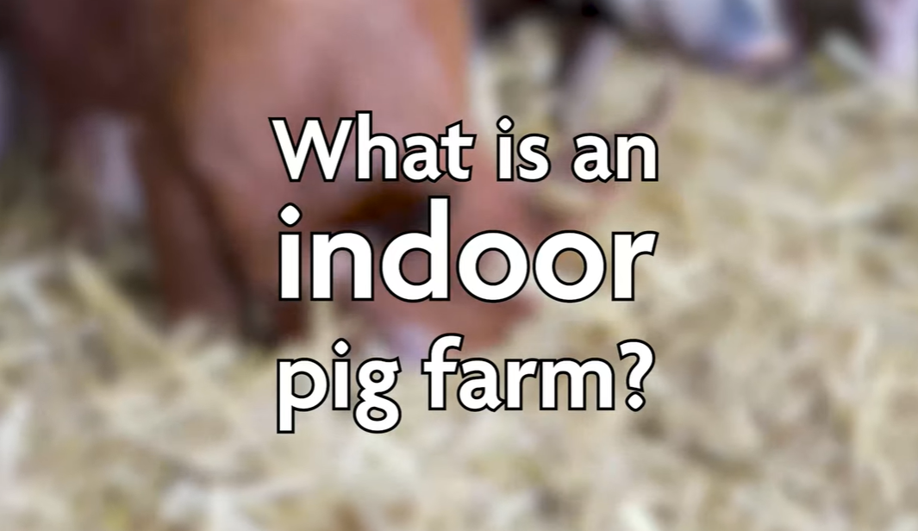
Pigs can also be raised indoors in
specially designed pig houses
Notes:
YouTube links:
What Is An Indoor Pig Farm? – YouTube (slide 3)
https://youtu.be/9Szdt7cfChU?si=dU4-Cz-EJ9Qhgfdy – RSPCA video What Is An Indoor Pig Farm? (youtube.com) (slide 4)
https://youtube.com/clip/UgkxLe9fI1_EIazn83EXF6kYsTsmryEtUZlE?si=g6QFbotxtHbIANY6– Vicki and Kate compare indoor and outdoor This is British Pig Farming (youtube.com) (slide 5) https://youtube.com/clip/Ugkxqrb9nC825YFss4nRCwLKKU85WSX_jVva?si=qfRn6yG4FH9CKcae – red tractor This is British Pig Farming (youtube.com) (slide 6)

Slide 5
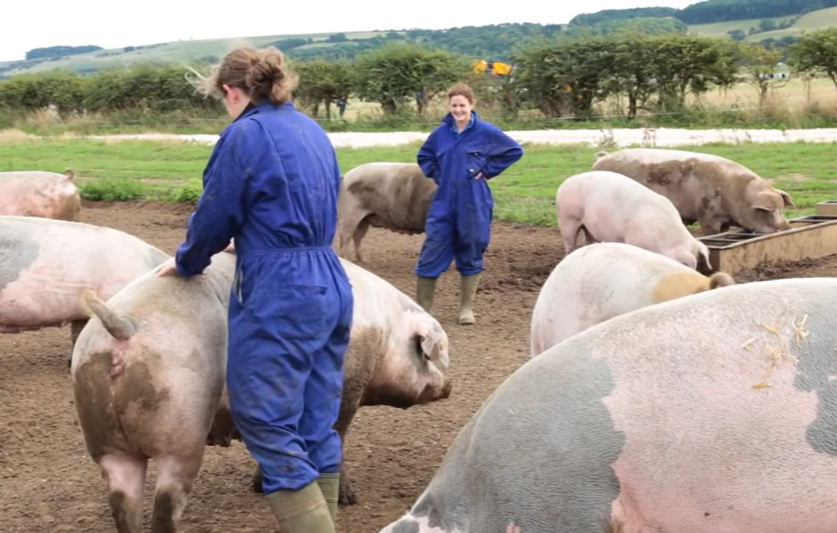
Ultimately, the system used will depend on
many factors. Can you think of some?
Notes:
Factors that will affect the choice of pig farming – indoor v. outdoor
Land available: Is it free draining? Is there enough land to be able to move the pigs every 2 years? How much space does an average pig need outdoors (indoors v. outdoors)?
Is there enough capital to build and furnish an indoor pig unit? It would be a huge capital outlay. What would the payback period be?
What about the skills and knowledge needed to start up an indoor and/or outdoor unit? Although an indoor unit is more efficient, it requires a lot more infrastructure and a more technically skilled workforce. While an outdoor pig unit requires staff that understand the environmental challenges. Is there skilled and experienced labour available locally?
It would be a lot quicker to set up the infrastructure for an outdoor pig unit compared to an indoor unit. What are the planning restrictions for each in that area? It can take up to 8 years to get permission for a brand new indoor unit.
Pig farmers can rent land for a short period of time (2 years) and then move onto a different area; it is a more flexible system and can benefit from farmers using the pigs to revive and fertilise fields which would usually grow arable crops. So, outdoor pig farmers do not need to own their own land or get tied into long-term tenancy arrangements which would involve maintenance and long-term investment.
Students now complete questions 1 and 2 on their worksheet.
This is British Pig Farming (youtube.com)

Slide 6
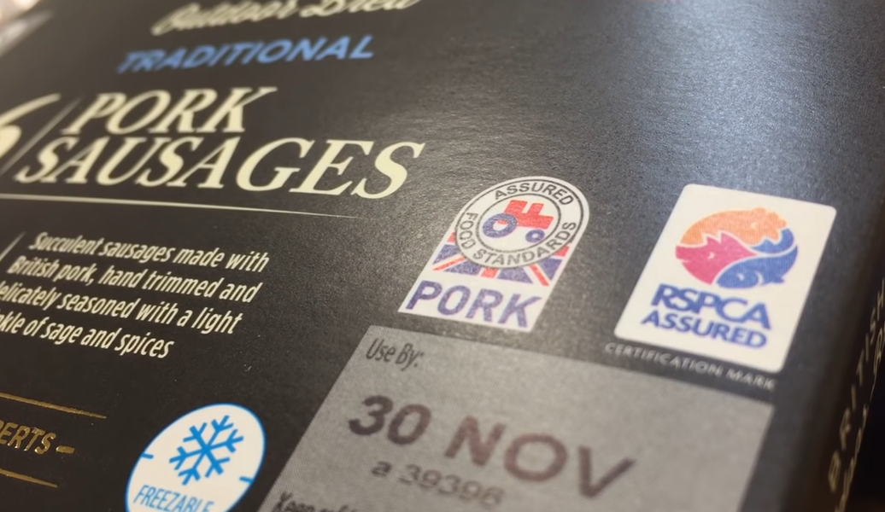
Pork production in the UK is very closely monitored to ensure the pigs are well cared for
Can you think of food you buy that has these logos?
Why are the logos important for consumers and producers?
&
Notes:
Important for consumers:
Confident that the farms involved in the production of the food are well managed and regularly monitored to ensure that standards continue to be met – Red Tractor Assurance Scheme | British Food Supply Chain Standards
Traceability means consumers can be confident that the pork product has been produced to a high standard
Important for producers:
Adds value to their product, making them more competitive against non-UK products
Recognises the efforts that they go to ensure that they are well managed
Market access – many retailers insist that their suppliers have Red Tractor accreditation
Student task: Explore the Red Tractor website and imagine that you are a retailer. Why would you want to stock produce which has Red Tractor accreditation?
Students now complete question 3 on their worksheet.
More information regarding veterinary involvement - https://youtube.com/clip/UgkxDVSDNR0zObhkBM7r7659hflSsOgliLVe?si=_9Xvw5w4jR1xNpAh – vet This is British Pig Farming - YouTube

Slide 7
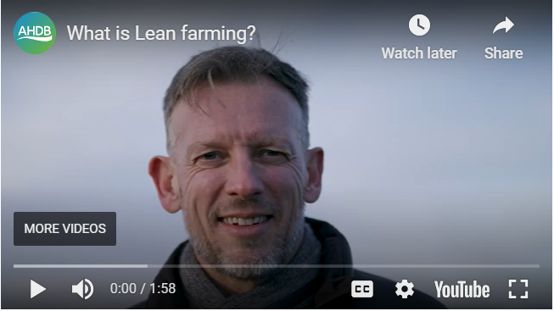
Meet Neil Fedden, Lean Consultant
Managing Director of Fedden USP
&
Notes:
Lean management for farmers and growers | AHDB
The concept of lean management stems from Japanese philosophy known as Kaizen, which means ‘change for the better’. The Kaizen philosophy teaches us to make small changes over time to create improvements within a business, recognising that a small change in the present can make a huge impact in the future.
Lean is a business management methodology based on Kaizen. When implemented, it minimises the waste and maximises the value of a product for the end customer, without compromising quality. Lean encompasses three key concepts:
Delivering more customer value
Minimising waste
Continuously improving
If these concepts are embraced, a culture of continuous improvement is created. Successful implementation of Lean in the agriculture and horticulture industry requires both management and staff to adopt it. It is crucial that staff are able to differentiate between the processes that add value, and those classified as waste. Staff-led continuous improvement makes sure that achievements are not only sustainable but that members of staff have the skills to identify future business improvements.
New business terms from the video:
Waste walk – a detailed analysis of how the business works – can help to use post it notes on a map of the farm to see how the different elements work together, a bit like a jigsaw puzzle.
Launceston Farm case study – £40,000 savings
Feed routines – how often animals are being fed and what are they being fed
Feed and forage – this tends to mean the additional feed that is being given to supplement grass (while forage is grass that has been cut and stored (dry as hay, or damp as haylage or grass silage))
Stocking density – how many animals are being kept in a specific area, i.e. number of cows per hectare (1000m2)
Winter forage – the excess grass that was cut in the summer and then stored to be fed in the winter (hay, haylage or silage)
Overgrazing – having too many animals eating grass on too small an area so that the grass struggles to keep growing and the soil becomes damaged and takes longer to repair itself impactiing the quality and quantity of grass

Slide 8
The Importance of a Waste Walk
Waste is any step in a process that does not add value. A waste walk must take place under ‘normal’ conditions, if it is to be of any use. Waste can happen in lots of different ways:
Transport
Inventory/stock
Motion
Waiting
Overprocessing
Overproduction
Defects
Skills
Discuss in pairs: When you last made a cake, was there any waste?
&
Notes:
A waste walk involves closely watching and following a process or activity and looking for ‘waste’ in a structured way, one step at a time. Once wastes have been identified, you can prioritise which one(s) you want to address (and perhaps eliminate) first.
Waste is any step in a process that does not add value. There are three types of waste in Lean management: Muda, Mura and Muri.
Carry out waste walks under normal conditions – don’t make any changes to the usual routine.
Look for examples of waste under each of the following areas:
Transport: Is equipment being moved unnecessarily? This includes the movement of information, such as performance data that is not analysed.
Inventory: Are parts (machinery, medicines and chemicals) or information building up beyond the number needed or beyond their useful life? For example, sows that should have been culled and now produce fewer offspring that increase variation and workload.
Motion: Are people moving unnecessarily in and between areas that don't benefit the customer or end goal? This includes walking between different pieces of equipment or repetitive movements to reach poorly laid out equipment, e.g. in the AI tent.
Waiting: Are you losing time while you wait for supply chain materials (feed and straw), people (contractors) or information? This could include waiting for equipment to be delivered, e.g. missing tools.
Overprocessing: Are there too many steps involved in getting to the end result? Can some steps be merged or streamlined?
Overproduction: Is the farm infrastructure being pushed too far? This is not just about making more of something, it can also refer to making it too quickly resulting in unnecessary storage costs, e.g. higher stocking densities might mean you run out of space before pigs are ready to move.
Defects: These could include barren sows, pigs that are too heavy/light for the abattoir to process, and issues that can be avoided, e.g. broken kit that slows people down.
Skills: Are you making the full use of your team's skills, experience and creativity? This can sometimes take the form of highly skilled employees spending time on relatively unskilled tasks.
Students now complete questions 4, 5 and 6 on their worksheet.

Slide 9
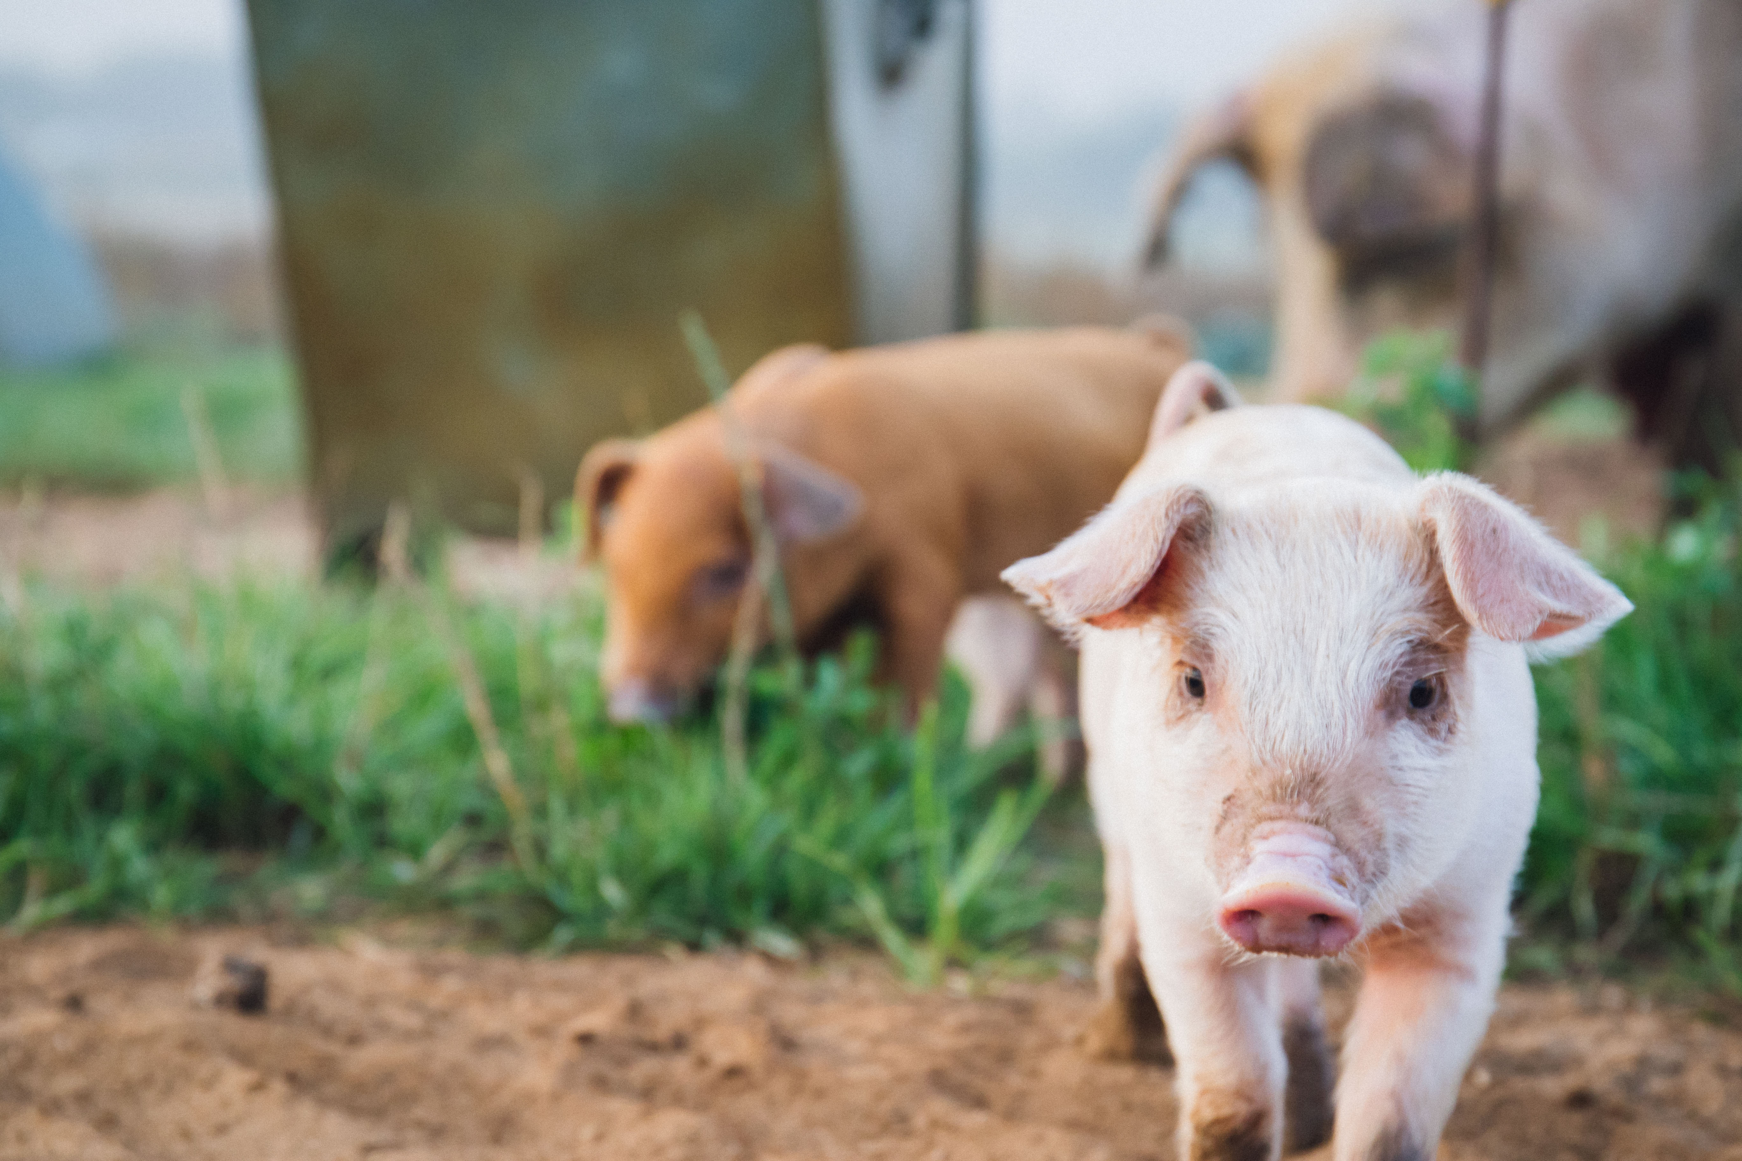
Examples of how
lean production has
helped pig farmers
improve their efficiency
&
Notes:
Read through the case study on their worksheets – Case study: Mark Hayward - Dingley Dell Pork
Students work in groups to match some farming problems with their ‘lean-management-inspired’ solutions. Each group should receive a hard copy of slides 10–15 that they can read and discuss. Students should work to match the problem described in each case study with one of the solutions on their worksheets.

Slide 10
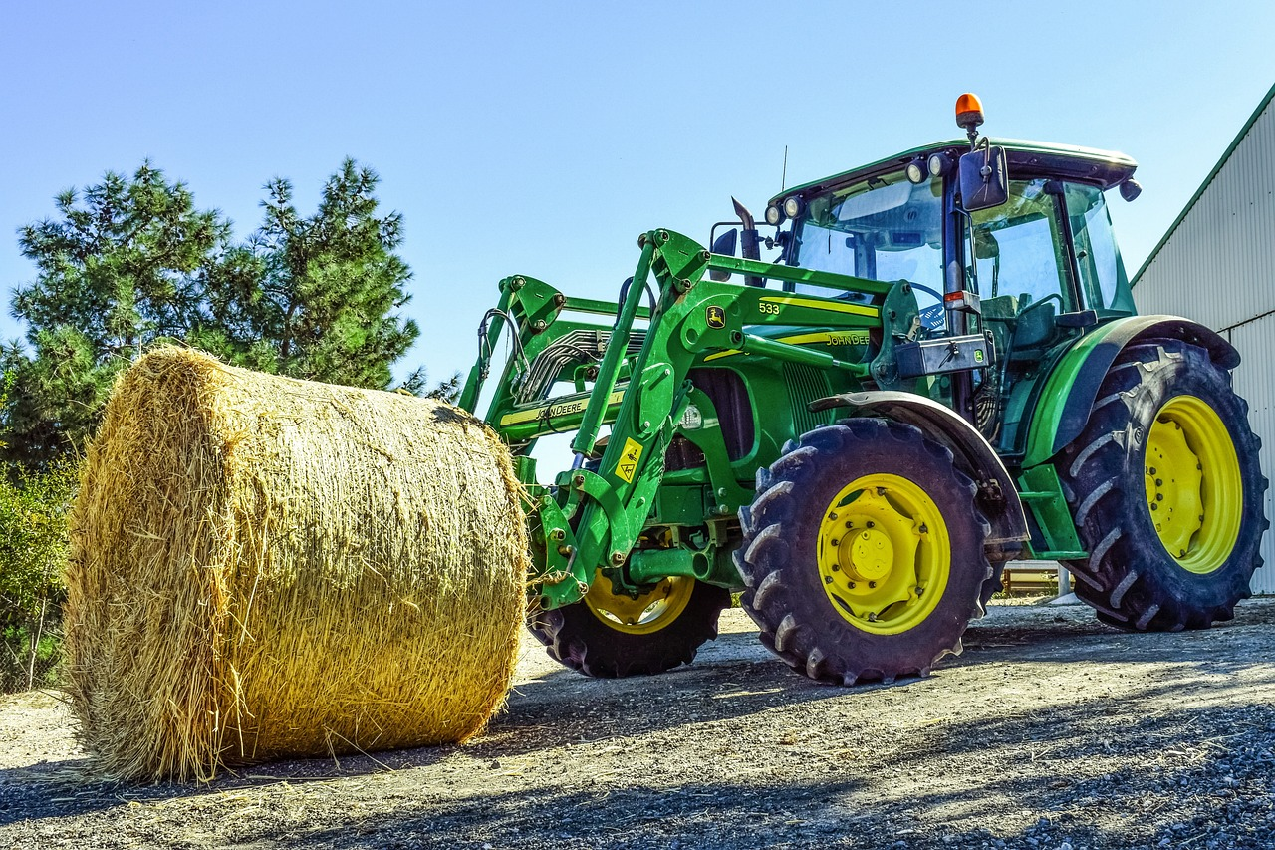
Examples of how pig farmers are
working towards lean production
Problem 1
A farmer with 800 sows that live outdoors. Before carrying out a waste walk, a loader was used to bring straw bales from a central point to bed up five finishing sheds. The loader could carry two bales at a time, which resulted in five roundtrips to collect the straw each time the sheds were mucked out. Each roundtrip took 15 minutes of time and used diesel to go back and forth.
&
Notes:
Case study: Consolidate journeys to save time and money
Find out how a farmer saved over £1,300 per year by streamlining the mucking out and bedding up process.
The problem
The unit: independent producer with 800 sows outdoors, finished indoors.
Before carrying out a waste walk, a loader was used to bring straw bales from a central point to bed up five finishing sheds. The loader could carry two bales at a time, which resulted in five roundtrips to collect the straw each time the sheds were mucked out. Each roundtrip took 15 minutes of time and also used diesel to go back and forth.
The solution (solution 2 on the worksheet)
Following a waste walk, the team decided that it would be more efficient to load all 10 bales onto a small trailer and take them to the finishing sheds in one trip. While it would take a few minutes to load and hitch the trailer, it would, overall, take less time than carrying out multiple roundtrips.
The costs
In this case, the small trailer was already owned by the farm, so there were no costs. However, if you needed to purchase a second-hand trailer, the costs would be circa £2,000.
The benefits
The estimated savings from implementing this new way of working are:
15 minutes per roundtrip, with three roundtrips saved (assuming it takes one trip to get there and 15 minutes to load the trailer in the morning)
45 minutes every other day
137 hours per year
£1,370 per year in labour costs (assuming £10 per hour wage)
Plus, diesel savings and the added benefit of a lower carbon footprint
These costs are conservative: in poor weather, when there are breakdowns and when vehicle maintenance is needed, this will increase the time and costs.
The farmer reported that these savings were notable and will enable him to reinvest the saved time into driving further efficiencies.

Slide 11
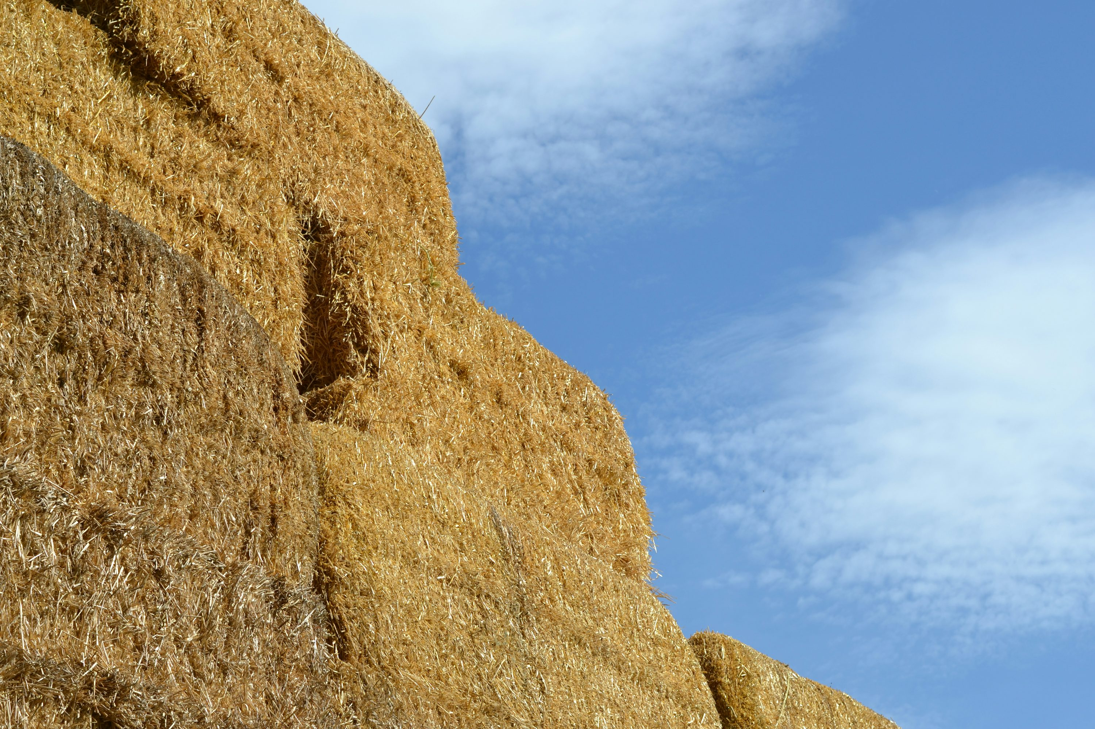
Examples of how pig farmers are
working towards lean production
Problem 2
A farmer with 1,000 sows on an indoor farrow-to-finish operation mucks out each shed three times a week, providing each shed with fresh straw. However, the team realised that at least once a week, they wouldn’t have a blade to cut the string around the bales. So, someone must go and look for a knife before the task can continue. While it only takes five minutes, this time soon adds up and breaks the flow of the task.
&
Notes:
Case study: Save time strawing up on a farrow-to-finish pig unit
Find out how the simple hack of hanging a penknife from a bale trolley saved one farmer £90 per year.
Back to: Lean management case studies in the pork sector
The problem
The unit: independent producer with 1,000 sows on an indoor farrow-to-finish unit.
Sheds are mucked out three times a week and provided with fresh straw. However, through conducting a waste walk, the team realised that at least once a week (if not more), they wouldn’t have a penknife to hand to cut the string around the bales. As a result, someone has to go and look for a knife before the task can continue. While it only takes five minutes to find a knife and return to the task, this time soon adds up and also breaks the flow of the task.
The solution (solution 1 on the worksheet)
Two solutions were discussed among the team:
Attach a penknife to the bale trolley with a chain so there is always a knife to hand.
Keep a length of bale twine on a nail by the door to split the bales using friction.
The costs
Both solutions are low-cost options: £10 for a penknife and chain, or no costs for option two.
The benefits
The estimated time saved from not having to look for a knife when mucking out equates to:
10 minutes per week
9 hours per year, or one shift (assuming a 9-hour day)
£90 per year in labour costs (assuming £10 per hour wage)
The farmer reported that with this task completed more quickly, time could be put into other areas of production to yield further efficiencies across the business.

Slide 12
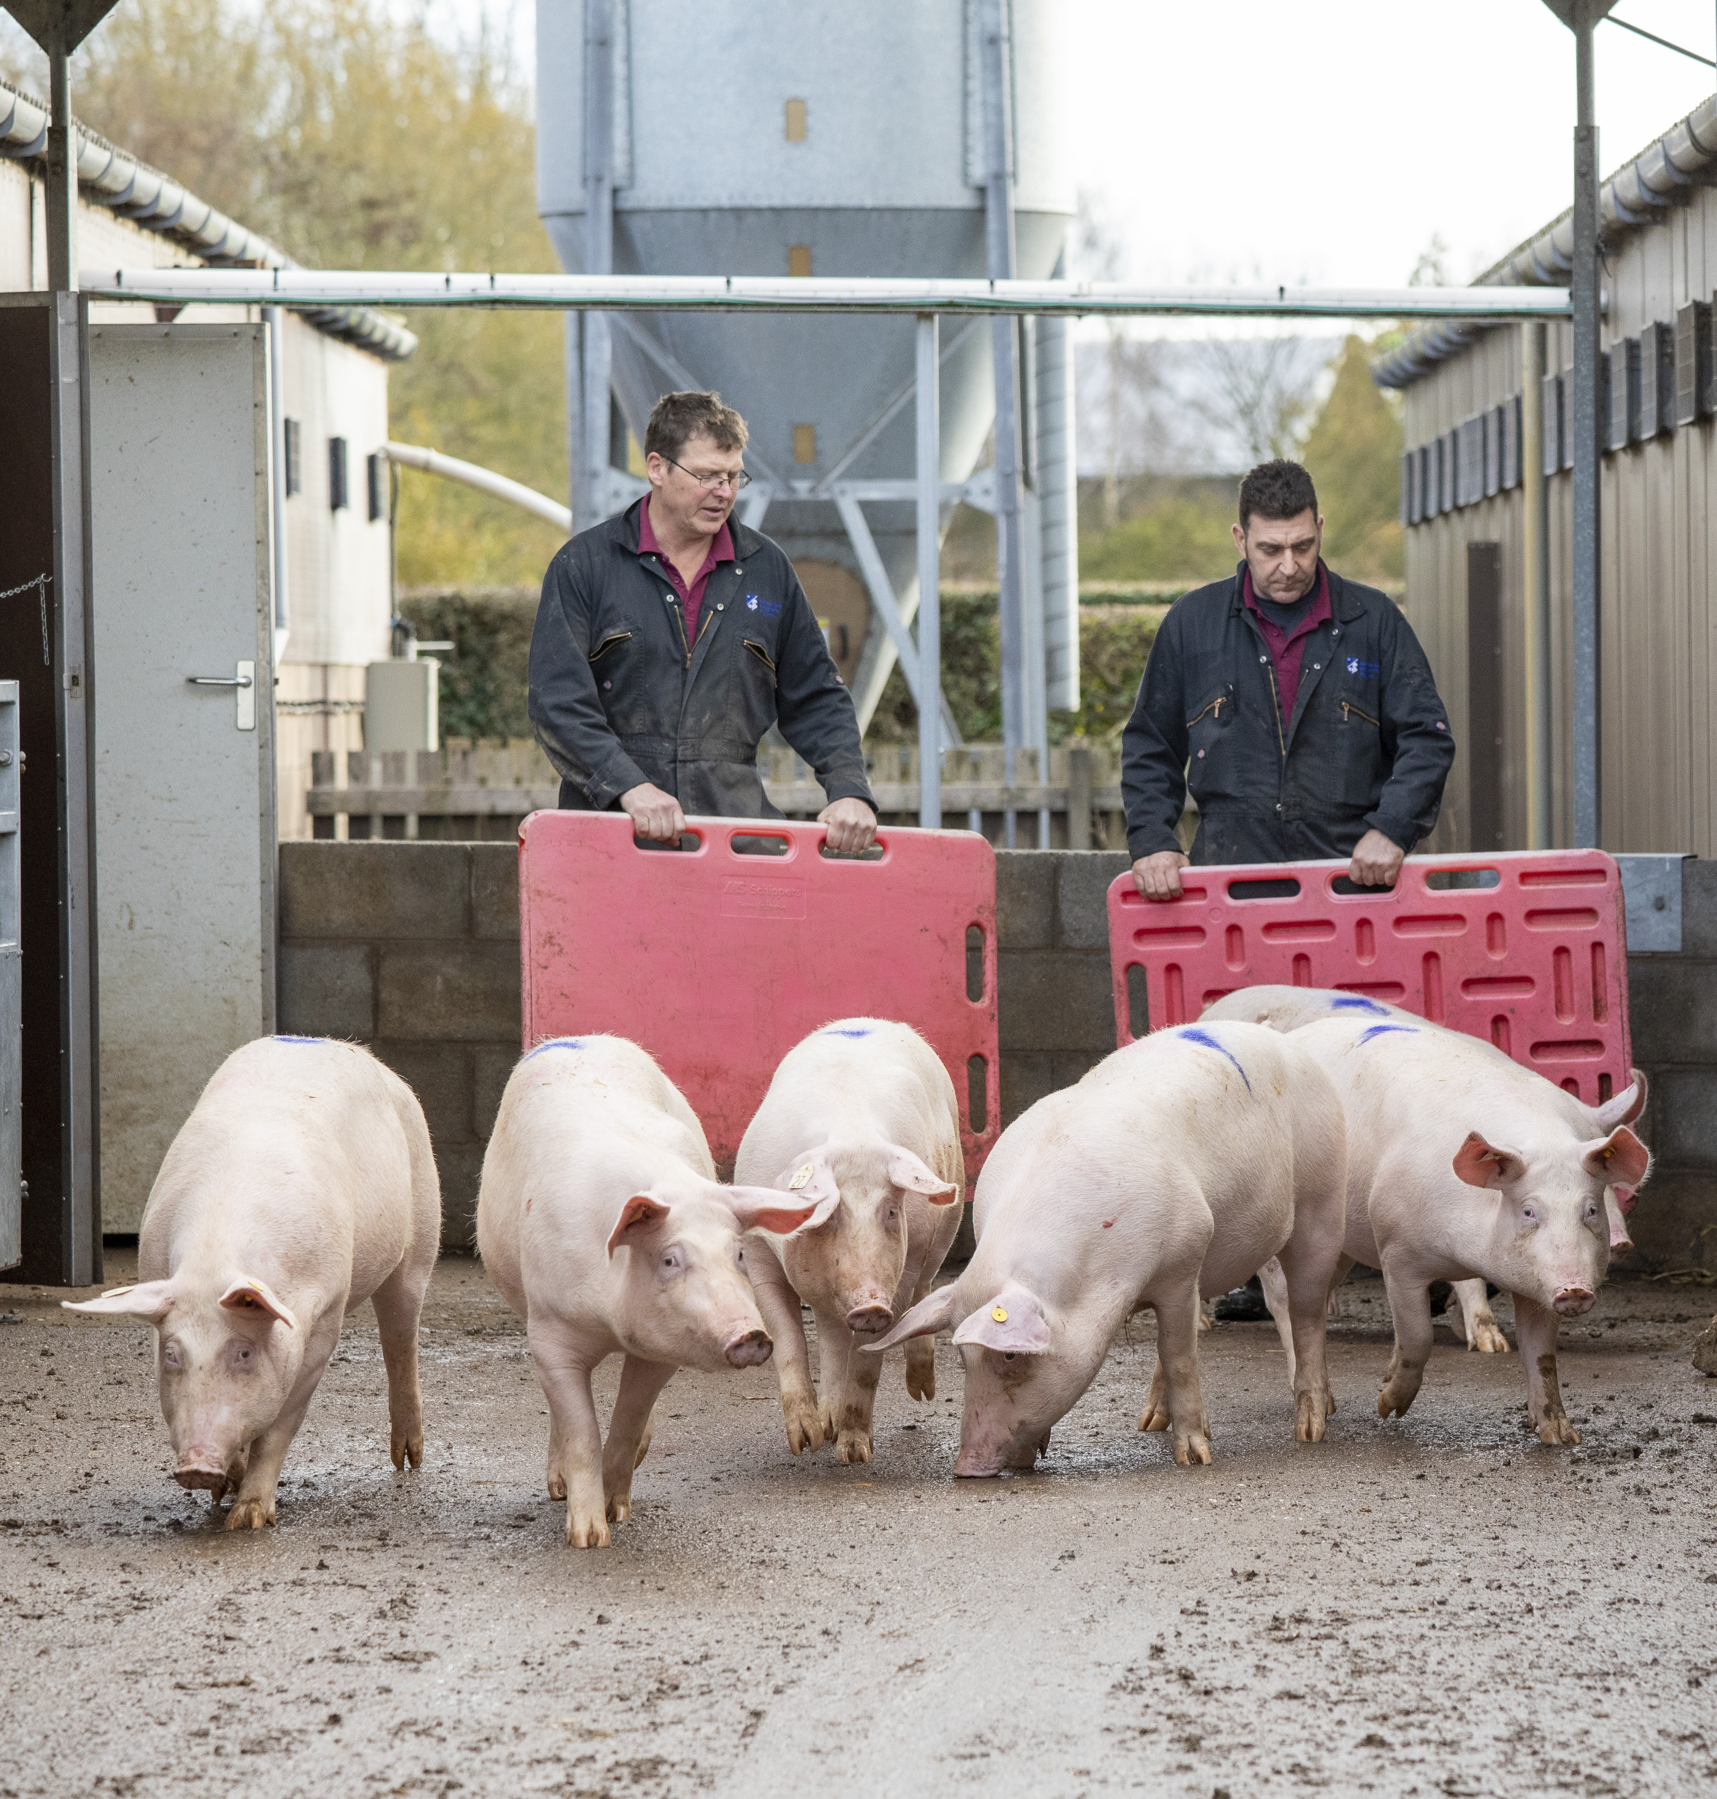
Examples of how pig farmers are
working towards lean production
Problem 3
A farmer with 1,000 sows sorts pigs ready for market into groups according to their weight before they are loaded onto trailers. The pens have two gates: one that is regularly used, as it can be closed off to allow staff to clean the central passage, and one at the rear just used for sorting the pigs.
During the waste walk, it was discussed that the sorting and loading process took a team of three staff approximately two hours to complete each time, as pigs were hesitant to exit via the rear of the pens.
&
Image credit: Dave Warren
Notes:
Capitalise on familiarity when moving and loading pigs
Find out how a simple change to the way pigs are moved and loaded saved over 40 hours over the course of a year.
The problem
The unit: indoor farrow-to-finish unit with more than 1,000 sows across a multi-site operation.
Finisher pigs are sorted into groups of bacon-weight pigs and loaded onto trailers. The finisher pens have two gates: one that can be closed off to allow staff to scrap the central dunging passage, and one at the rear used to sort the pigs.
Before the waste walk, pigs were pulled from their pens through a rear-access gate into a yard for loading. The sorting and loading process took a team of three staff approximately two hours to complete each time, as pigs were hesitant to exit via the rear of the pens
The solution (solution 6 on the worksheet)
Following the waste walk and discussion, the team decided to try sorting pigs through the internal gates into the central dunging passage that they are more familiar with, instead of through the rear gates.
The result was noticeable straightaway, with pigs being less stressed and hesitant and easier to sort and load.
The costs
No cost: This improvement only required a change in practice, rather than any investment.
The benefits
The time taken to complete the task fell from 1 hour 40 minutes to 20 minutes.
The estimated savings are:
1 hour 40 minutes per staff member, or five hours in total across the team of three, each time pigs are loaded
The task is repeated twice every three months (first and third draw), which equates to 40 hours saved over the course of a year
Total costs saved in a year through reduced labour is approximately £400 (assuming £10 per hour wage)
The most significant difference for staff was that the task was notably shorter and less stressful, which freed up time to complete other important tasks.
The pigs were also less stressed.

Slide 13
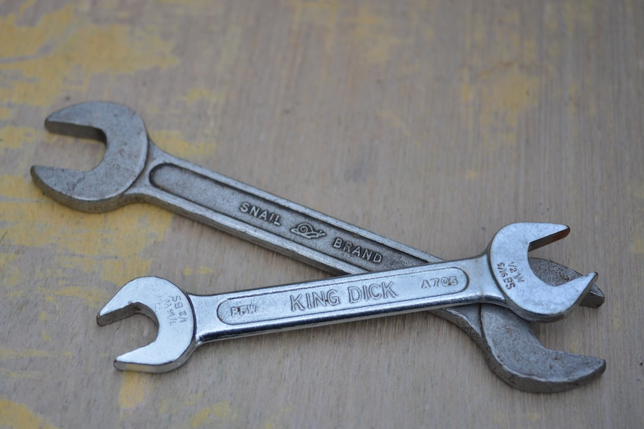
Examples of how pig farmers are
working towards lean production
Problem 4
A farmer with 1,000 sows and an arable enterprise discovered there was never the right-sized spanner to hand when needed, particularly during harvest when equipment needed maintenance and repair. This would happen 1–2 times a month, wasting about 15 minutes each time (looking and waiting), and more often during harvest, and could waste up to one hour each time to go and find a spanner and take it back to the field.
Equalling over 30 hours per year had been wasted through looking for the right tool (usually a 13mm spanner) to complete tasks.
&
Notes:
Case study: Shadow boards save farmer over £1,000 per year
This case study demonstrates how a simple low-cost change can improve efficiency as well as team relationships.
The problem
The unit: independent producer with 1,000 sows outdoors, finished indoors, alongside an arable enterprise.
Following a waste walk and discussions with the pig unit and arable staff, a recurring and frustrating issue was highlighted – there was never the right size spanner to hand when it was needed. This was an issue throughout the year, but particularly noted during harvest when equipment needed frequent adjustments, maintenance and repair.
As a result, work would come to a halt while someone went to find a spanner.
On the pig unit, and during winter on the arable unit, this would happen 1–2 times a month, wasting about 15 minutes each time (looking and waiting). During harvest, however, this happened more often and could waste up to one hour each time to go and find a spanner and take it back to the field.
Over the course of a year, the team calculated that more than 30 hours had been wasted through looking for the right tool (usually a 13mm spanner) to complete tasks.
The solution (solution 4 on the worksheet)
The team came up with two low-cost solutions:
Equip each member of staff with their own 13mm spanner.
Implement shadow boards alongside each piece of equipment or machinery that needs a 13mm spanner so it is obvious when tools are missing.
The team opted for the shadow boards, as personal spanners could be put down, lost or left in overalls. The shadow boards stay with the equipment and machinery, and provide a quick visual cue to make sure no tools are missing before leaving the yard. If anything is missing, they are replaced with new ones from the store before leaving for the day’s tasks.
The costs
£40 for 20 spanners (£2 per spanner, those not kept on shadow boards were kept in the store); 18 spanners were still present 12 months later
£20 for plywood and bolts to build the shadow boards
The benefits
The estimated time and cost saving was:
30 hours per year per person saved on expensive tasks (average cost per hour approximately £40)
Typical annual saving approximately £1,200
In addition to the time and cost savings, staff relationships are less strained, especially during the busy harvest periods

Slide 14
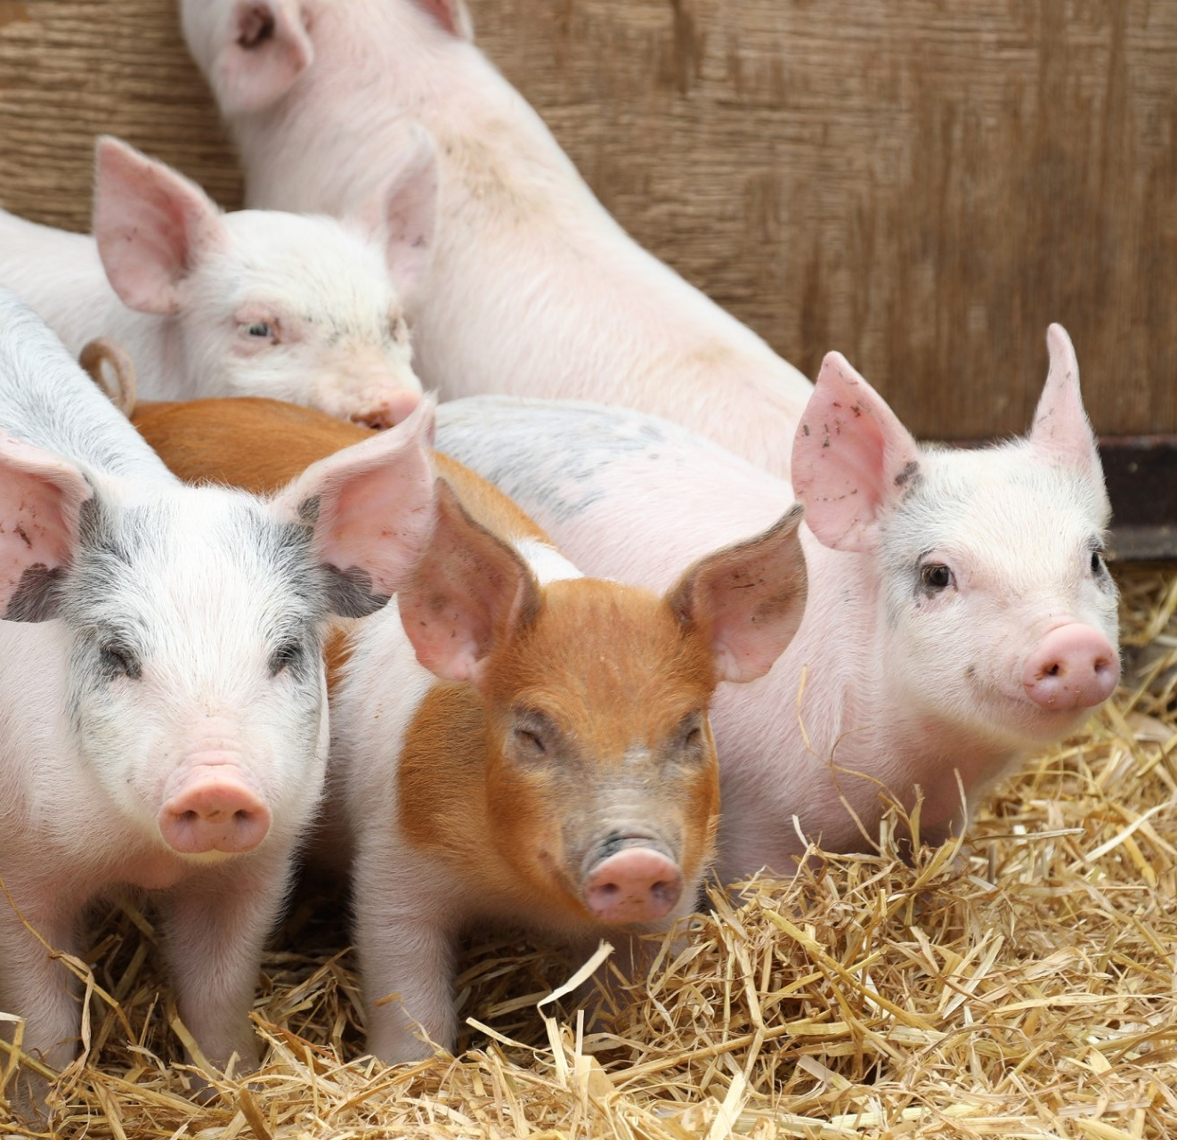
Examples of how pig farmers are
working towards lean production
Problem 5
A farmer with 1,000 sows uses two teams of two staff at weaning to sort piglets into a trailer with a maximum capacity of 150 piglets. Before a waste walk was carried out, the pens of piglets were emptied into a central passage, then sorted into batches of 150 piglets to load onto the trailer. But only one team of two is needed to load the piglets onto the trailer. This means that two people are waiting, and it could also result in double-counting and inaccurate numbers of piglets being loaded.
&
Notes:
Case study: Optimise staff time at weaning
Find out about the simple changes a producer made to add value and increase efficiency at weaning.
The problem.
The unit: independent farrow-to-finish producer with 1,000 sows.
At weaning, two teams of two staff remove the sows from the farrowing crates and then sort the piglets as they are moved to their new accommodation. The trailer used to take the piglets to the farrowing sheds has a maximum capacity of 150 piglets.
Before a waste walk was carried out, the pens of piglets were emptied into a central passage then sorted into batches of 150 piglets to load onto the trailer.
Only one team of two is needed to load the piglets onto the trailer. This means at any given period, two people are waiting, and it could also result in double-counting and inaccurate numbers of piglets being loaded.
The solution (solution 3 on the worksheet)
The passage in the farrowing shed is long enough to be split into three sections in which to sort the piglets into three batches of 150. This would allow one team to load piglets onto the trailer, while the other could continue to sort piglets.
Having sectioned areas also enabled the team to sort piglets by gender and size and made it easier to identify any light piglets.
The costs
There were no costs to implement this change in practice.
The benefits
Estimated time and cost savings:
1 hour every three weeks (based on two staff waiting to load or sort piglets)
17 hours per year
£170 per annum in labour costs (assuming £10 per hour wage)
While the savings are minimal, the real value realised by the farmer came from:
Sorting piglets by size leading to consistent groups of finishing pigs
Tighter finishing weights, with more pigs meeting the target specification
The ability to structure trials and interventions based on gender and size
Being able to stream light pigs and manage them separately
This example demonstrates how a change of practice can not only save time and money, but also help find other opportunities to add value and increase efficiency.

Slide 15
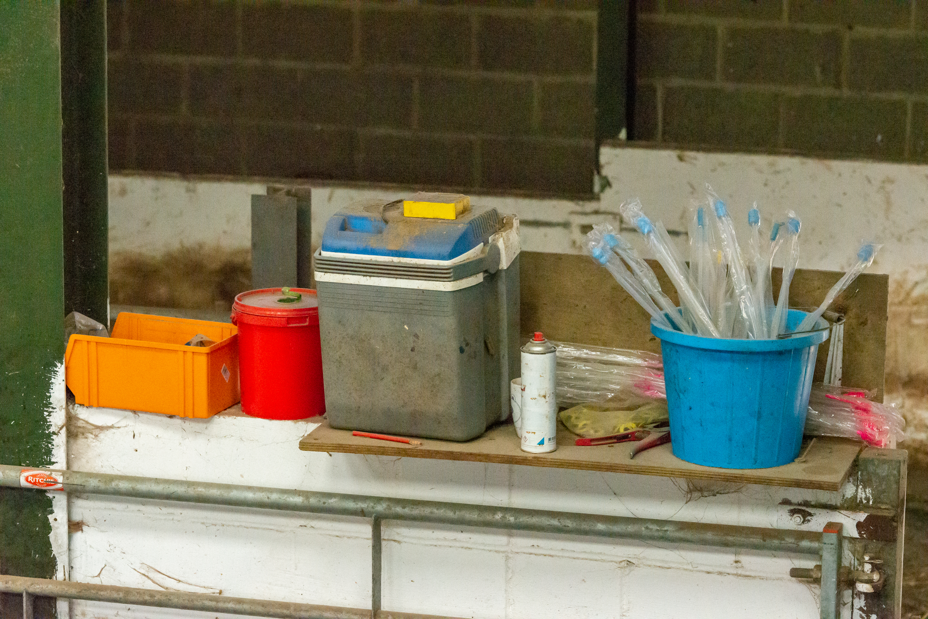
Examples of how pig farmers are
working towards lean production
Problem 6
A farmer with an outdoor breeding unit with groups of 48 pigs being serviced using AI (artificial insemination) every week. The generator used to power the AI cooler was positioned just outside the service tent. This meant that to collect each dose of semen, staff had to walk back and forth from one side of the tent to the other. Each trip took roughly 20 seconds, and the walking back and forth also caused sows to become slightly more agitated, resulting in extra time needed to allow sows to settle before service.
&
Image credit: John Eveson
Notes:
Case study: Low-cost investment saves time in service tent
Find out how a simple extension cable improved efficiency and staff performance on an outdoor breeding unit.
The problem
The unit: outdoor breeding unit with over 1,000 sows on a single site; each service group consists of 48 pigs running on a continuous (weekly) system.
The generator used to power the artificial insemination (AI) cooler was positioned just outside the service tent. The AI cooler was placed on a shelf against one side of the tent so it could be plugged directly into the generator. The temporary AI stalls ran along the centre of the tent, parallel with the boar pens.
This meant that to collect each dose of semen, staff had to walk back and forth from one side of the tent to the other. Each trip took roughly 20 seconds (not including opening and closing the cooler) and the walking back and forth also caused sows to become slightly more agitated, resulting in extra time needed to allow sows to settle before service.
The solution (solution 5 on the worksheet)
A 15-metre extension cable was purchased so the AI cooler could be moved to the centre of the pen. This reduced the time to collect semen doses by 15 seconds.
The costs
15-metre extension cable at a cost of £10.
The benefits
A time saving of 15 seconds per dose across 48 serves equates to 12 minutes
With two services (minimum) per week, this is a saving of 24 minutes per week
20 hours per year or £200 in labour (assuming £10 per hour wage); this is a conservative estimate as the back and forth often took longer than 15 seconds e.g. dodging sows
While staff found it challenging to notice 20 hours over a year, additional improvements were made to the AI process as a result of the waste walk and moving the cooler to the centre of the tent:
Fewer reports of staff collecting multiple AI doses to save on trips
Sows were less agitated
More time for checks, e.g. standing heat, hygiene and correct handling of semen
Staff felt less pressured and the AI process was a lot calmer

Slide 16
What did all the pig farmers have in common that helped them to successfully implement lean production?
Open to change
Good communication within the business
Keen to empower employees
Able to invest time and resources
Flexible approach to managing employees
Ability to alter procedures and try new ways of working
Which of these do you consider to be the most important?
&
Notes:
Students now complete question 8 on their worksheet.

Slide 17
Summary Questions
Brainstorm the main barriers of lean production.
Describe what efficiency within the pork industry looks like.
Explain two ways in which wastage on farm could reduce efficiency.
Analyse how lean production could lead to a more motivated workforce.
Quality is an important aspect of lean production; how do food assurance schemes, such as the Red Tractor, help to ensure consistently high standards within the UK pork industry?
&
Notes:
Students now complete questions 8–12 on their worksheet.
Barriers of lean production – attitudes to change, knowledge and skills to identify solutions, time, finance to implement improvements, technology doesn’t exist yet, legislative restrictions.
Efficiency – minimal wastage, empowered and motivated staff, fully utilised resources, reduced costs, maximum output, consistently high-quality output
Wastage can reduce efficiency – resources are wasted when output is poor quality and has to be replaced or requires more attention/inputs, reducing efficiency. Wastage of feed, increases feed costs and staff waiting (or poorly trained) wastes time and increases labour costs. An increase in costs reduces efficiency and reduces efficiency and inevitably profitability.
Lean production and staff motivation – a team waste walk is an excellent example of how to listen to and empower staff so that they feel more valued. Likewise, implementing lean production may mean that roles become more varied and that training is implemented. Both are regarded as motivational - Maslow’s esteem needs and Herzberg’s motivators.
Quality – farms within the Red Tractor food assurance scheme are regularly visited by qualified Assessors who ensure that they meet the high standards which the logo represents.
Within the (Pork Standards | Red Tractor), farms must meet the following standards:
1. All staff working on a Red Tractor certified farm must be trained and demonstrably competent to carry out their job
2 All Red Tractor pigs must be identified by either tag, tattoo or mark before leaving the farm to maintain traceability
3. Safe, comfortable and hygienic housing must be available, i.e. they must be kept clean, well lit, well ventilated, safe and secure.
4. Pigs must have sufficiently sized housing and be kept in appropriate groups i.e. safe stable social groups to minimise fighting to establish a social hierarchy, usually achieved by having pigs of a similar size together.
5. Pigs kept outdoors must have access to shelter and bedding must be provided for thermal comfort, so they can be comfortable in both hot and cold temperatures.
6. Pigs must receive a full and healthy diet, have access to clean water.
7. Health and welfare of the pigs must be proactively managed, through routine visits from the vet and environmental enrichment to keep them stimulated.

Slide 18
‘In life, change is inevitable.
In business, change is vital.’
Warren G. Bennis – Leadership expert
Notes:
For more information on the pork industry - AHDB Pork | AHDB
For more information on food assurance schemes visit - Home Page | LEAF (Linking Environment and Farming) and RSPCA Assured UK - Farm Animal and Chicken Welfare
For more information on careers and opportunities within the pork industry visit - For Teachers | LEAF (Linking Environment and Farming), Careers in farming and growing – TIAH, Farming careers and personal development – Farmers Weekly (fwi.co.uk),

