Slide 1
A CLA lesson plan for The Countryside Code:
WAYMARKER MEMORY GAME

Slide 2
WAYMARKER MEMORY GAME INSTRUCTIONS
Split your class into smaller groups.
Print off a set of slides (slides 4-19), for each group.
Mix the order of the slides up and place face down on to the table.
Can the pupils work together in their groups to match the symbol card with the correct definition card?
Ask pupils to turn one card over. If the next card they turn over is a matching pair, put that pair of cards to one side.
If they don’t find a matching pair, they must place both cards face down on the table again.
Pupils must memorise where the matching cards are in order to find the pair.
You may like to split each group into two teams to make the session more exciting. The team that finds the most matching pairs wins.

Slide 3


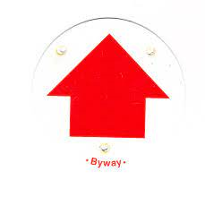




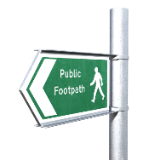
ANSWER REFERENCE SHEET
Footpath
Bridleway
Restricted Byway
BOAT
National Trail Acorn
Open Access Land
Permissive Path
Fingerpost Sign

Slide 4
FOOTPATH
Open to walkers only.
Waymarked with a yellow arrow.

Slide 5
Footpath

Slide 6
bridleway
Open to walkers, horse riders and cyclists.
Waymarked with a blue arrow.

Slide 7
BRIDLEWAY

Slide 8
RESTRICTED byway
Open to walkers, cyclists, horse riders and drawn vehicles.
Waymarked with a purple arrow.

Slide 9
Restricted byway

Slide 10
BYWAY OPEN TO ALL TRAFFIC (BOAT)
Open to walkers, cyclists, drawn vehicles and motor vehicles.
Waymarked with a red arrow.

Slide 11
BYWAY OPEN TO ALL TRAFFIC (BOAT)

Slide 12
NATIONAL TRAIL ACORN
National Trails can be used for walking, with horse riding and cycling possible on some trails or parts of trails.

Slide 13
NATIONAL TRAIL ACORN

Slide 14
Open access land
You can walk and explore away from paths.

Slide 15
Open access land

Slide 16
PERMISSIVE PATH
Follow advice on local signs as landowners voluntarily provide access to these paths and choose who can use them.

Slide 17
Permissive path

Slide 18
FINGERPOST SIGN
These signs are used when a route leaves a hard surfaced road. The sign points in the direction of the route. From this point waymarkers are used.

Slide 19

Fingerpost sign

Slide 20
CLA
16 Belgrave Square, London SW1X 8PQ
020 7235 0511
mail@cla.org.uk

