Slide 1
Factors Influencing Variations in Runoff: Soil Structure and Infiltration

Slide 2
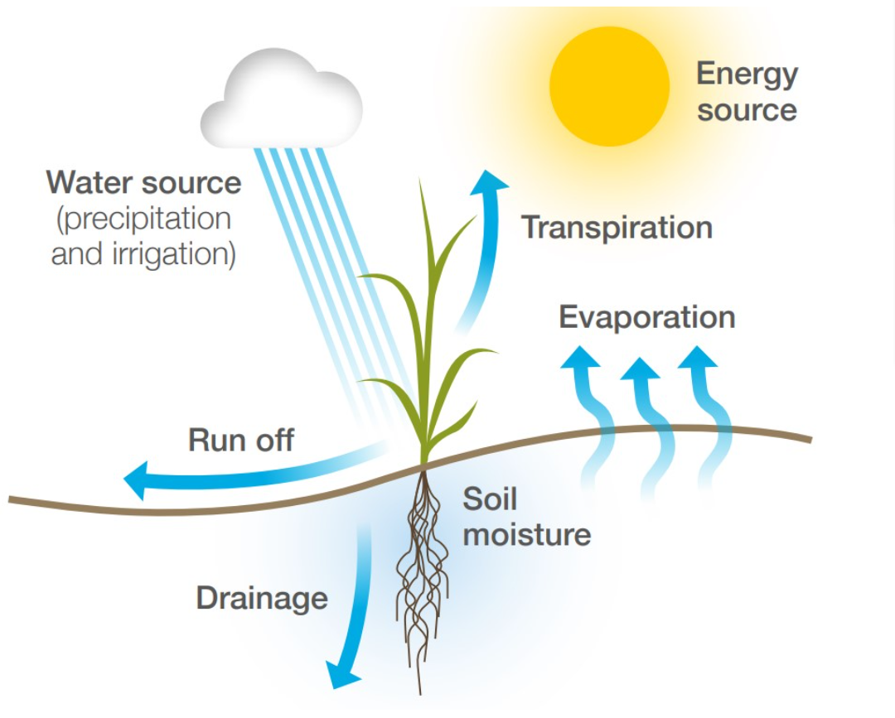
Objectives
To understand drainage basins as open systems – stores and flows
The interpretation of flood hydrographs
To consider factors influencing runoff variation
To understand human-induced changes in the water cycle (including farming practices and land use change)
To consider to role soil structure plays in infiltration and runoff

Slide 3
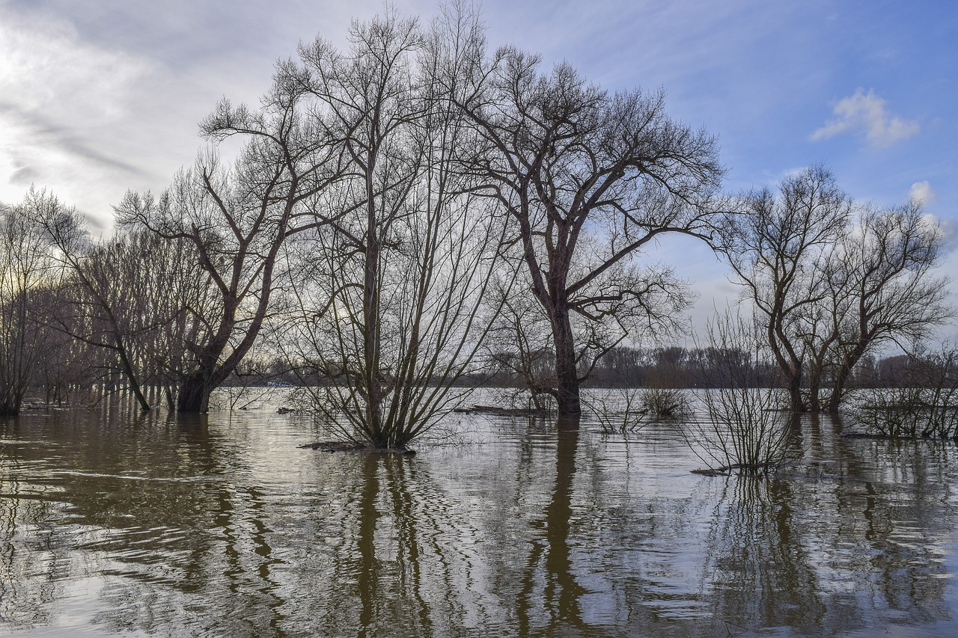
How might farmers be impacted by extreme weather events such as flooding?
How can effective management of agricultural land help reduce the frequency and severity of flooding events?

Slide 4
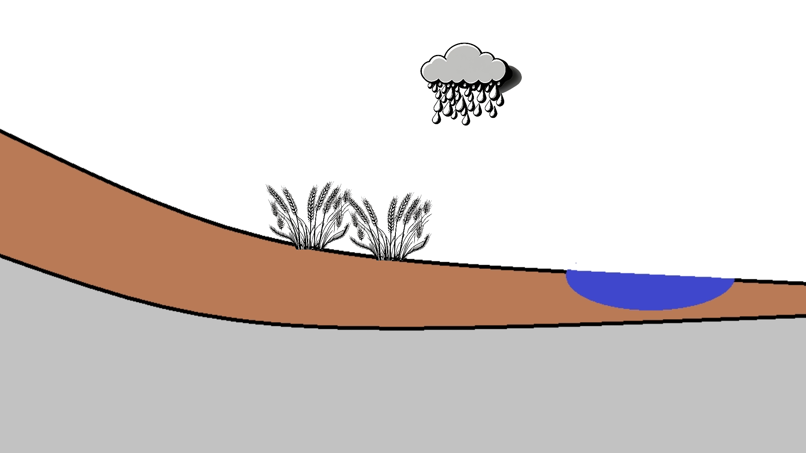
Picture a farm. The farm is within the drainage basin of a river prone to flooding…
Water can be stored within the drainage basin
Interception storage
Vegetation storage
Soil storage
Surface storage
Key
Inputs
Outputs
Storage
Channel storage
Groundwater storage

Slide 5
Picture a farm. The farm is within the drainage basin of a river prone to flooding…
Water enters and leaves the drainage basin. It is an open system with inputs and outputs.
Evaporation
Precipitation
Transpiration
River discharge
Key
Inputs
Outputs

Slide 6
Picture a farm. The farm is within the drainage basin of a river prone to flooding…
The water moves within the basin. These ‘flows’ have different rates. Surface runoff is faster than flows within soil and rock.
Surface runoff
Infiltration (into soil)
Throughflow & Stem flow
Key
Inputs
Outputs
Storage
Flows
Percolation
Through flow (in soil)
Channel flow
Interflow (in permeable rock)
Groundwater flow

Slide 7

Picture a farm. The farm is within the drainage basin of a river prone to flooding…
Using this diagram, can you suggest processes or factors that could increase the risk of flooding?
Evaporation
Precipitation
Surface runoff
Transpiration
Interception storage
Infiltration (into soil)
Throughflow & Stem flow
Vegetation storage
Soil storage
Surface storage
River discharge
Key
Inputs
Outputs
Storage
Flows
Channel storage
Percolation
Through flow (in soil)
Channel flow
Interflow (in permeable rock)
Groundwater storage
Groundwater flow

Slide 8
The rainfall in the drainage basin is monitored and recorded. Precipitation is recorded.
Peak rainfall

Slide 9
Falling limb

Slide 10
The river discharge is monitored. This is recorded in cubic metres per second or cumecs (m³/s).

Slide 11
Peak discharge
Peak rainfall
Lag time

Slide 12
On this graph, much of the river discharge results from surface runoff. Base flow is water reaching the river as a result of groundwater flow.
Surface runoff

Slide 13
The green line shows how the discharge might look if runoff were less. There is a longer lag time and lower peak discharge.

Slide 14
Many natural factors influence runoff
Size and shape of the drainage basin, e.g. small steep-sided basins, tend towards shorter lag times as the water reaches the river channel more quickly
Rock and soil type, e.g. permeable rocks and soils, will have increased storage capacity. This results in a longer lag time
Seasonal variations also play a role. For example, in the winter, deciduous woodlands intercept less rainfall

Slide 15
Human factors also influence runoff
Deforestation reduces interception
Removal of organic matter and exposure of the soil
Water reaching the soil surface rapidly is more prone to runoff and infiltration is reduced
The construction of impermeable surfaces such as roads prevents infiltration and increases the rate at which water reaches water courses

Slide 16
How could the farmland within this imagined drainage basin be managed to reduce runoff decreasing peak flow in the river channel?
Evaporation
Precipitation
Surface runoff
Transpiration
Interception storage
Infiltration (into soil)
Throughflow & Stem flow
Vegetation storage
Soil storage
Surface storage
River discharge
Channel storage
Percolation
Through flow (in soil)
Channel flow
Key
Inputs
Outputs
Storage
Flows
Interflow (in permeable rock)
Groundwater storage
Groundwater flow

Slide 17

Some key management strategies include…
Improving soil structure | Increasing interception
Well-managed soils with good structures allow more infiltration* Modern farming practices can help avoid soil compaction or other forms of damage Farms can monitor and assess their soil structures and change their management accordingly* For example, a farmer may reduce livestock access to areas where soil compaction is detected. Or, may seek strategies to reduce or optimise tillage (the mechanical preparation of land, e.g. ploughing). | Farming practices that decrease the exposure of bare soil will help reduce runoff Examples might include the use of cover crops. These non-cash crops are often grown over a single winter to cover bare soil and stubble. They protect the soil before the establishment of the next cash crop.
*option for practical field study

