Slide 1
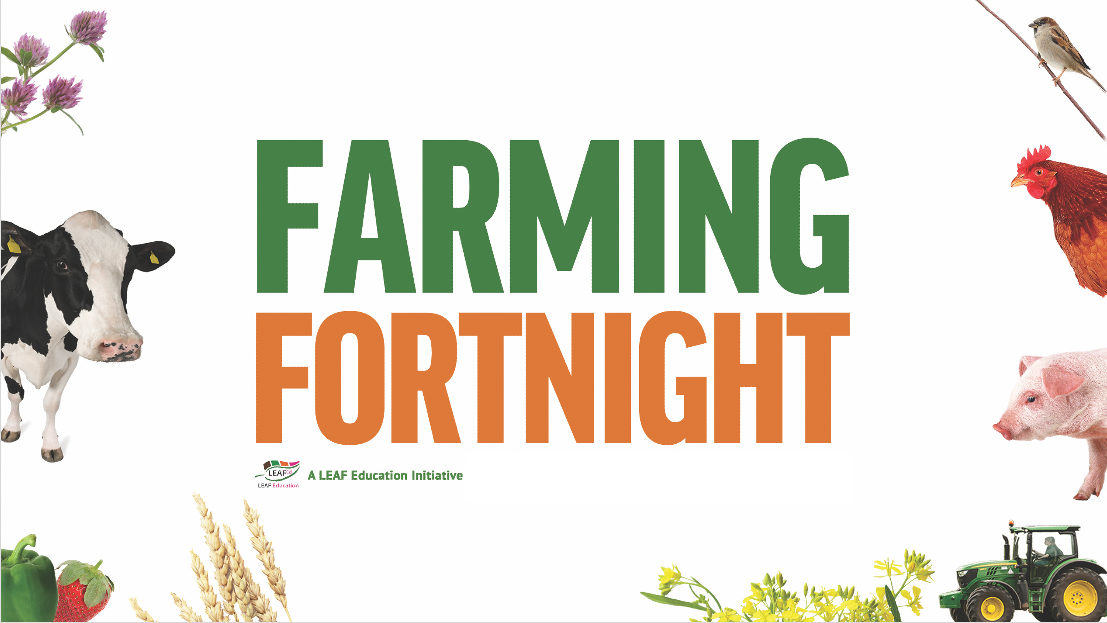

Slide 2
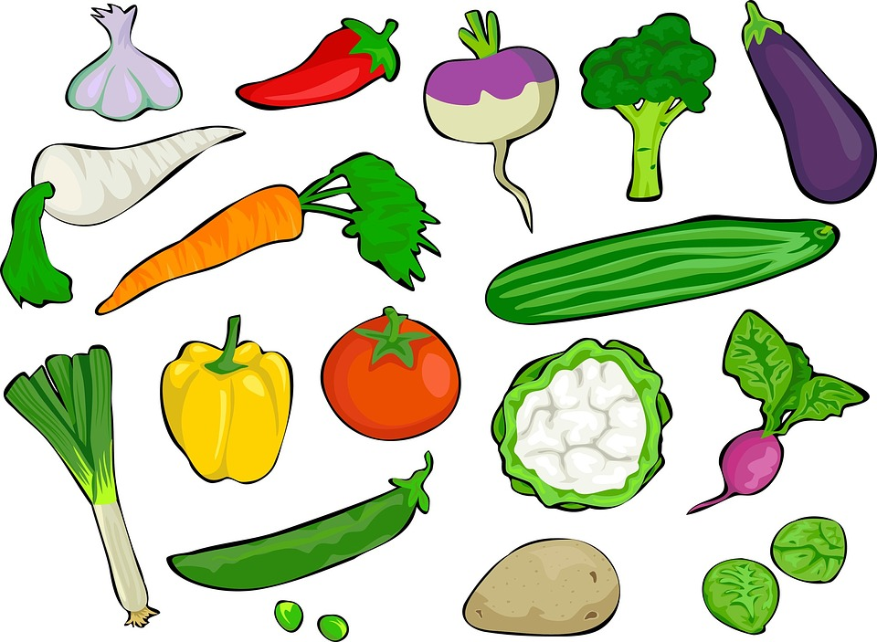
Are you getting your 5 a day?
#TastyTuesday
How many foods can you recognise?

Slide 3
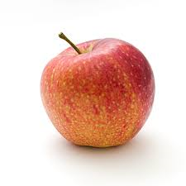
Are you getting your 5 a day?
#TastyTuesday
If apples are harvested in the autumn, how are they available in the shops all year round?
Notes:
They are stored in large warehouses and kept under specific conditions to ensure that they do not over ripen.

Slide 4
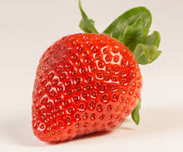
Are you getting your 5 a day?
#TastyTuesday
If strawberries are only ready to be harvested in late spring, how are they available in the shops most of the year?
Notes:
Strawberries are grown in large poly tunnels so that they are protected from harsh weather conditions and kept warm so that they benefit from a longer harvesting season.

Slide 5
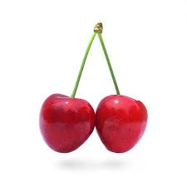
Are you getting your 5 a day?
#TastyTuesday
If cherries are only ripe in the summer, how are they available in the shops most of the year?
Notes:
They are also grown abroad and transported to the UK.

Slide 6
Are you getting your 5 a day?
#TastyTuesday
How else has modern technology benefited fruit and vegetable production?

Slide 7
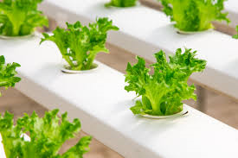
Are you getting your 5 a day?
#TastyTuesday
Plants can be grown in water rather than soil.

Slide 8
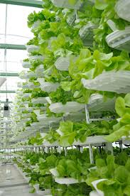
Are you getting your 5 a day?
#TastyTuesday
Plants can be grown on shelves rather than on the ground.

Slide 9
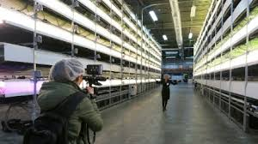
Are you getting your 5 a day?
#TastyTuesday
Plants can be grown without any sunshine, even underground!

Slide 10
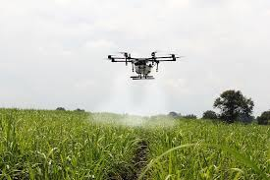
Are you getting your 5 a day?
#TastyTuesday
Drones can help farmers to monitor their crops and to look after them.

Slide 11
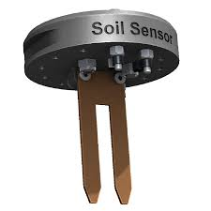
Are you getting your 5 a day?
#TastyTuesday
Sensors can monitor the condition of the soil and alert farmers when they need to act.

Slide 12
Are you getting your 5 a day?
#TastyTuesday
Watch the #TastyTuesday video

